Slide 1
Decision Tree
Machine Learning
Raj K Baliyar Singh
ML, Data Science

Slide 2
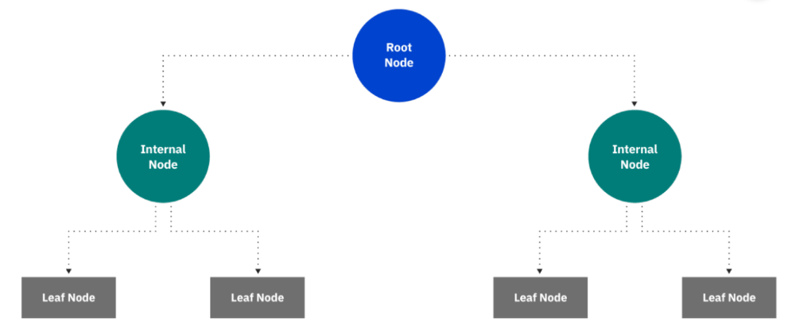
A decision tree is a non-parametric supervised learning algorithm, which is utilized for both classification and regression tasks. It has a hierarchical, tree structure, which consists of a root node, branches, internal nodes, and leaf nodes.

Slide 3
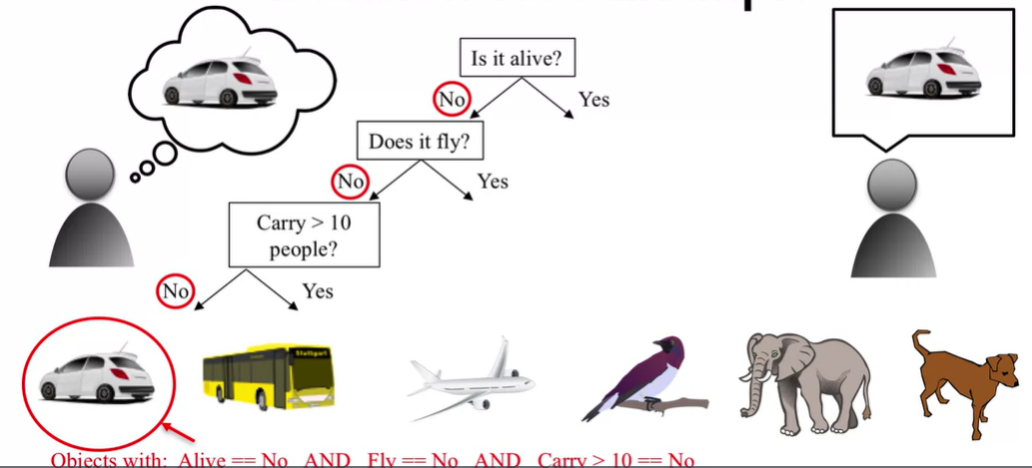
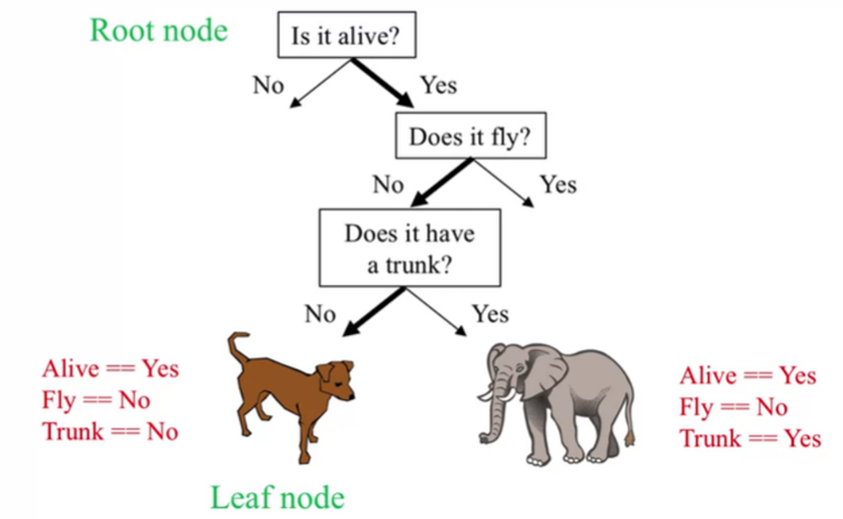

Slide 4
Root Node: It represents the entire population or sample, and this further gets divided into two or more homogeneous sets.
Leaf/ Terminal Node: Nodes that do not split are called Leaf or Terminal Node.
Decision Node: When a sub-node splits into further sub-nodes, then it is called a decision node.
Branch / Sub-Tree: A subsection of the entire tree is called a branch or sub-tree.
Parent and Child Node: A node, which is divided into sub-nodes, is called the parent node of sub-nodes, whereas sub-nodes are the child of the parent node.
Splitting: It is a process of dividing a node into two or more sub-nodes.
Pruning: Pruning is when we selectively remove branches from a tree. The goal is to remove unwanted branches, improve the tree’s structure, and direct new, healthy growth.

Slide 5
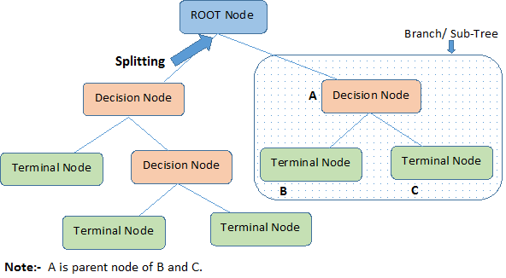

Slide 6
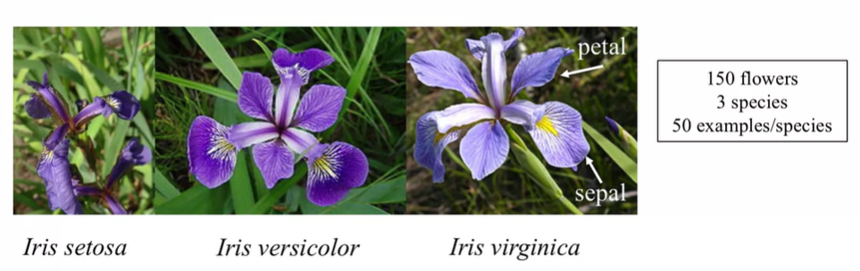
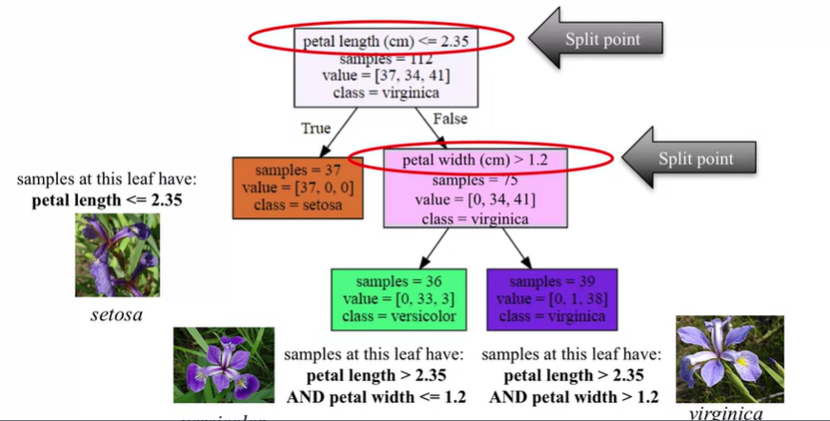

Slide 7
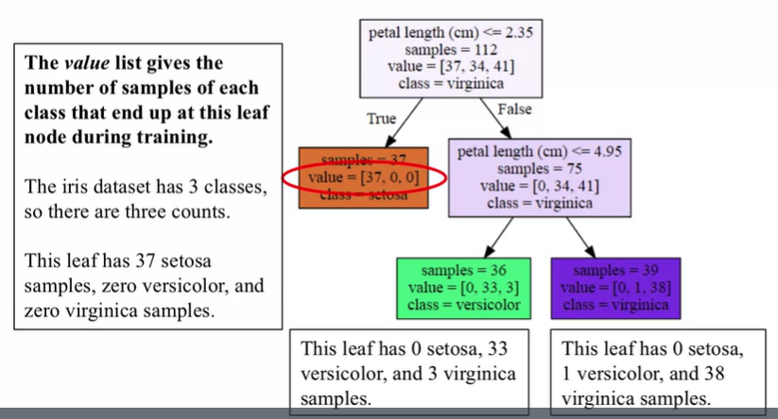

Slide 8

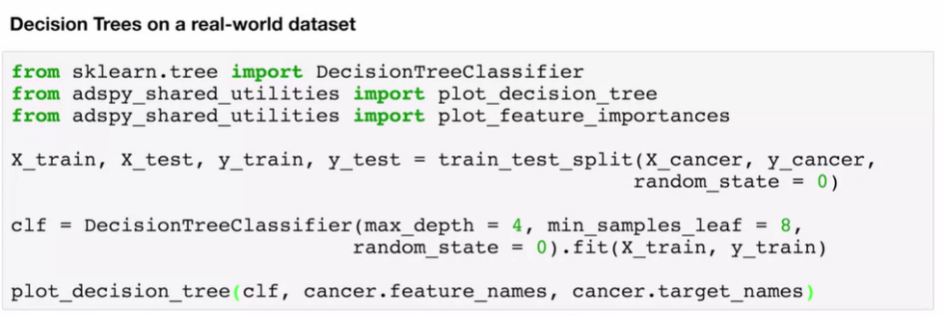

Slide 9
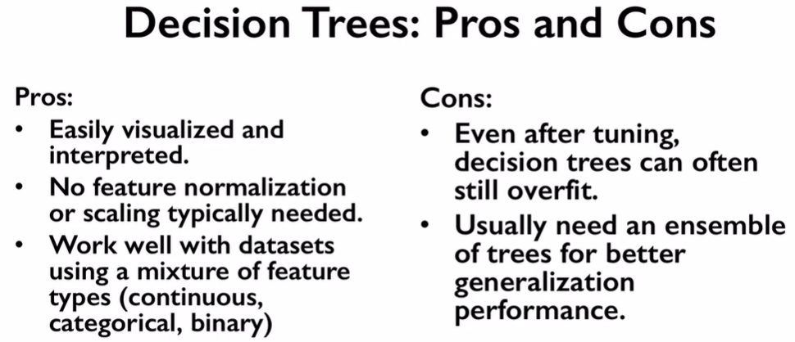

Slide 10
why you should use the Decision Tree:
It is considered to be the most understandable Machine Learning algorithm, and it can be easily interpreted.
It can be used for classification and regression problems.
Unlike most Machine Learning algorithms, it works effectively with non-linear data.
Constructing a Decision Tree is a speedy process since it uses only one feature per node to split the data.
Decision Trees model data as a “Tree” of hierarchical branches. They make branches until they reach “Leaves” that represent predictions. Due to their branching structure, Decision Trees can easily model non-linear relationships.

